Slide 1
EPICS Database
Kay Kasemir,
SNS/ORNL
Many slides from Andrew Johnson, APS/ANL
Feb. 2013

Slide 2
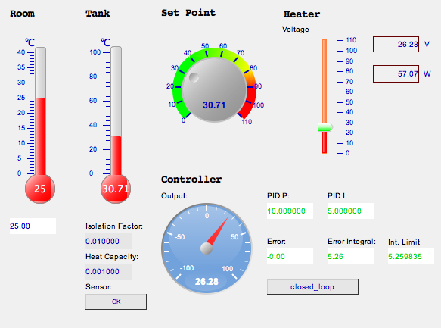
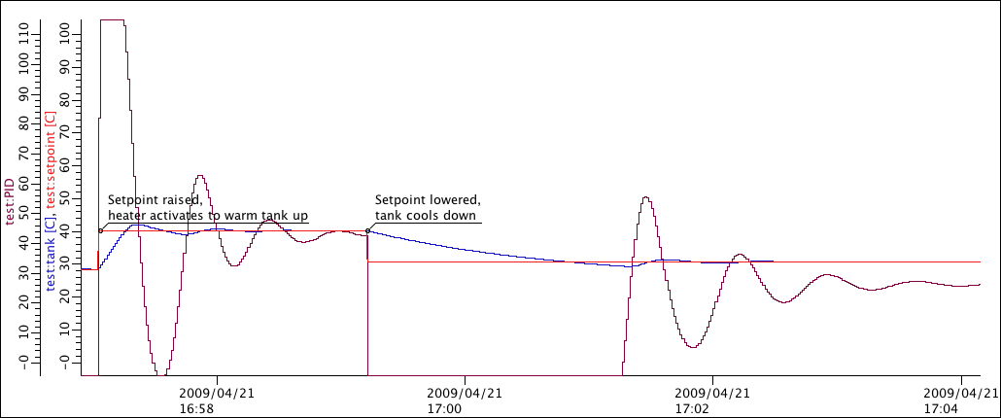
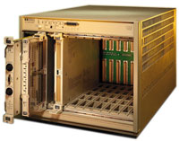
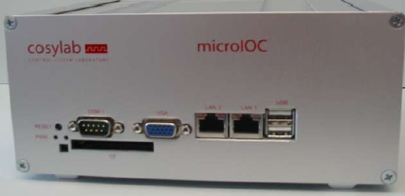
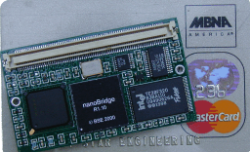
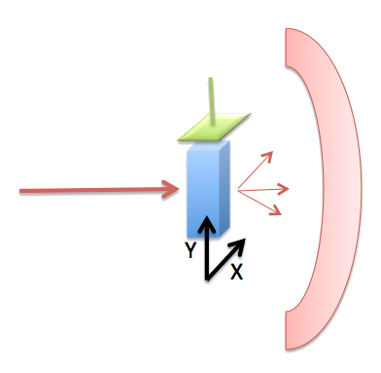
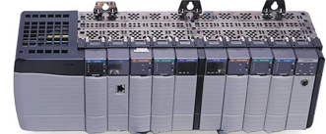

Distributed EPICS Setup
Operator Interface
Input/Output
Controller (IOC)
Channel Access

Slide 3
IOC
LAN
Database:
Data Flow,
mostly periodic
processing
Sequencer:
State machine,
mostly
on-demand
“Hard” IOCs run vxWorks and directly interface to A/D, D/A, LLRF, … hardware.
“Soft” IOCs run on Linux etc. and have no I/O Hardware other than serial or networked devices (Moxa to motor controller, …)
IOC
Channel Access
Database
Sequencer
Device Support
I/O Hardware

Slide 4
IOC Database
'iocCore' software loads and executes 'Records'
  Configuration of records instead of custom Coding
All control system toolboxes have (better?)
  GUI tools
  Network protocols
  Hardware drivers
  but few have a comparable database!

Slide 5
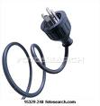

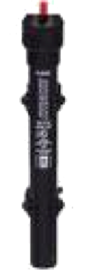
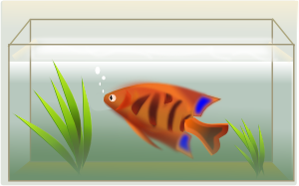

Example: Basic Temperature Control
  Task:
  Read temperature
  Open/close switch as needed
  Repeat
Software?

Slide 6
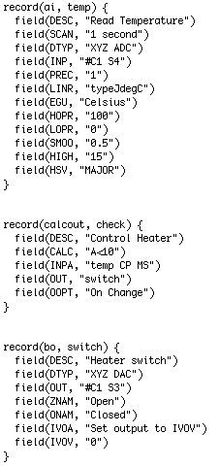
One Fishy Database
Analog Input Record
SCAN Field
Binary Output Record

Slide 7
Database = Records + Fields + Links
IOC loads and executes one or more databases
Each database has records
Each record has
  Name (unique on the whole network)
  Fields (properties, can be read, most also written at runtime)
  Often device support to interface to hardware
  Links to other records

Slide 8
Records are Active
Records ‘do’ things
  Get data from other records or hardware
  Perform calculations
  Check value ranges, raise alarms
  Write to other records or hardware
  What they do depends on record type and field values
… when they are processed
  Records process periodically or when triggered by events or other records
  No action occurs unless a record is processed

Slide 9
Record Types
ai/ao: Analog input/output
  Read/write number, map to engineering units
bi/bo: Binary in/out
  Read/write bit, map to string
calc: Formula
mbbi/mbbo: Multi-bit-binary in/out
  Read/write 16-bit number, map bit patterns to strings
stringin/out, longin/out, seq, compress, histogram, waveform, sub, …

Slide 10
Common Fields
Design Time
  NAME: Record name, unique on network!
  DESC: Description
  SCAN: Scan mechanism
  PHAS: Scan phase
  PINI: Process once on initialization?
  FLNK: Forward link
Runtime
  TIME: Time stamp
  SEVR, STAT: Alarm Severity, Status
  PACT: Process active
  TPRO: Trace processing
  UDF: Undefined? Never processed?
  PROC: Force processing

Slide 11
Record Scanning
SCAN field:
  When processed by other records:
  “Passive” (default)
  Periodically:
  “.1 second”, “.2 second”, “.5 second”,
  “1 second”, “2 second”, “5 second”, “10 second”
  On event:
  “Event” (EVNT field selects the event),
  “I/O Intr” (if device support allows this)
PHAS field
  Adds order to records that are on the same periodic scan
    First PHAS=0, then PHAS=1, …
PINI
  Set to “YES” to force record once on startup.
  Good idea for “operator input” records that are hardly ever changed, so they have an initial value.
PROC
  Writing to this field will process a record

Slide 12
Example “first.db”
# The simplest record that 'does' something
# and produces changing numbers
record(calc, "$(S):random")
{
field(SCAN, "1 second")
field(INPA, "10")
field(CALC, "RNDM*A")
}
Execute: softIoc –m S=$USER –d first.db
In another terminal: camonitor $USER:random
Try dbl, dbpr, dbpf

Slide 13
Common Input/Output Record Fields
DTYP: Device type
INP/OUT: Where to read/write
RVAL: Raw (16 bit) value
VAL: Engineering unit value
Output Only:
DOL: Desired Output Link.
Output records read this link to get VAL, then write to OUT…
OMSL: .. if Output Mode Select = closed_loop
IVOA: Invalid Output Action
DRVL, DRVH: Drive limits

Slide 14
More from “first.db”
# A ramp from 0 to 'limit', were limit
# can be configured via a separate record
record(ao, "$(S):limit")
{
field(DRVH, "100")
field(DOL, "10")
field(PINI, "YES")
}
record(calc, "$(S):ramp")
{
field(SCAN, "1 second")
field(INPA, "$(S):ramp")
field(INPB, "$(S):limit")
field(CALC, "A<B ? A+1 : 0")
}
Using ‘output’.
‘input’ would also work, since there’s no hardware to read or write, but only ‘output’ has DRVH…
Reading inputs:
A = my own current value
B = value of ..limit record
Which record is scanned?

Slide 15
Analog Record Fields
EGU: Engineering units name
LINR: Linearization (No, Slope, breakpoint table)
EGUL, EGUF, ESLO, EOFF: Parameters for LINR
LOLO, LOW, HIGH, HIHI: Alarm Limits
LLSV, LSV, HSV, HHSV: Alarm severities

Slide 16
Binary Record Fields
ZNAM, ONAM: State name for “zero”, “one”
ZSV, OSV: Alarm severities

Slide 17
Record Links
Input links may be
  Constant number: “0”, “3.14”. “-1.6e-19”
Input or Output links may be
  Name of other record’s field: “other”, “other.VAL”, “other.A”
    If other record is in same IOC: “Database link”
    If name not found: “Channel Access link”
  Hardware link
    Details depend on device support
    DTYP field selects device support
    Format examples: “@plc12 some_tag”, “#C1 S4”
A record’s FLNK field processes anther record after current record is ‘done’
Notes:
EPICS Database Lecture

Slide 18
Record (Database, Channel Access) Links
Format: “record.field {flags}”
  VAL is default for field
Flags:
  PP: Process a passive target record
    INP, DOL: Before reading
    OUT: After writing
  NPP: non-process-passive (default)
  MS: Maximize severity
  NMS: non-MS (default)
  MSS: Maximize Severity and Status
  MSI: .. when severity = INVALID
Example:
  field(“INP”, “other_rec.VAL PP MS”)

Slide 19
Additional Channel Access Link Flags
CA: Force CA link, even though target in same IOC
CP: For INP link, process on received CA monitor
CPP: CP, but only if SCAN=Passive
.. This won’t make any sense until we learn more about Channel Access…
The IOC Application Developer’s Guide,
Chapter 5 on Data Base .. Processing
is worth reading.

Slide 20
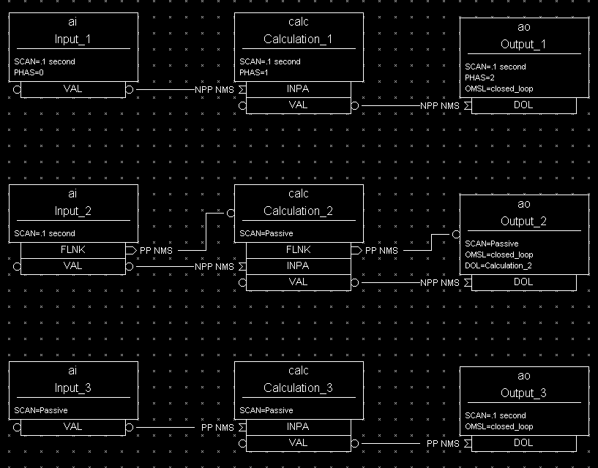
Processing chains
Notes:
EPICS Database Lecture

Slide 21
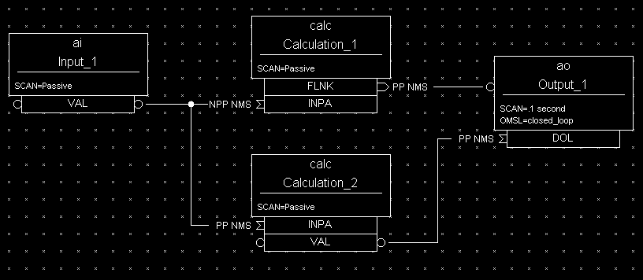
Which record is never processed?
Notes:
EPICS Database Lecture

Slide 22
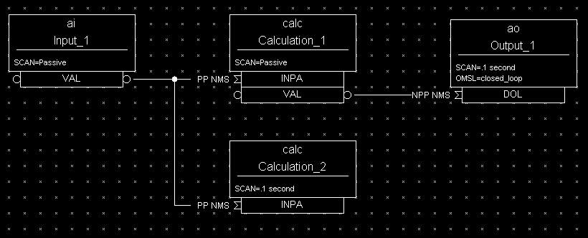
How often is Input_1 processed?
Notes:
EPICS Database Lecture

Slide 23
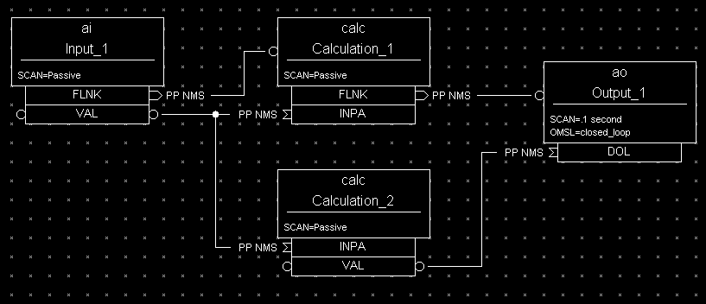
How long will this take?
PACT: Processing Active
Notes:
EPICS Database Lecture

Slide 24
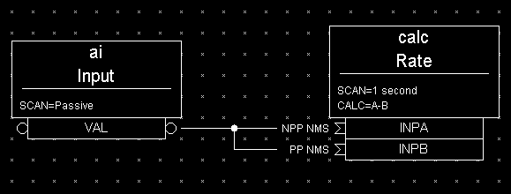
Rate Of Change Example
Calculating “Rate-of-Change” of an Input
INPA fetches data that is 1 second old because it does not request processing of the AI record. INPB fetches current data because it requests the AI record to process. The subtraction of these two values reflects the ‘rate of change’ (difference/sec) of the pressure reading.

Slide 25
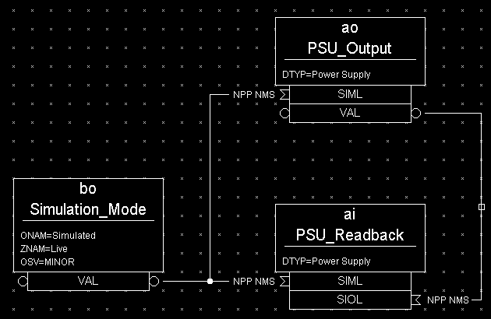
Simulation Mode
When in simulation mode, the AO record does not call device support and the AI record fetches its input from the AO record.

Slide 26
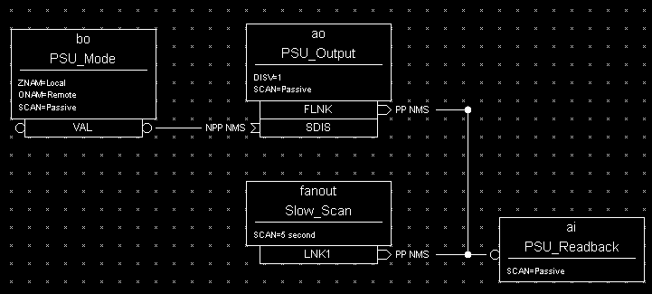
Multiple Scan Triggers
Slow Periodic Scan with Fast Change Response
The AI record gets processed every 5 seconds AND whenever the AO record is changed. This provides immediate response to an operator's changes even though the normal scan rate is very slow. Changes to the power supply settings are inhibited by the BO record, which represents a Local/Remote switch.

Slide 27
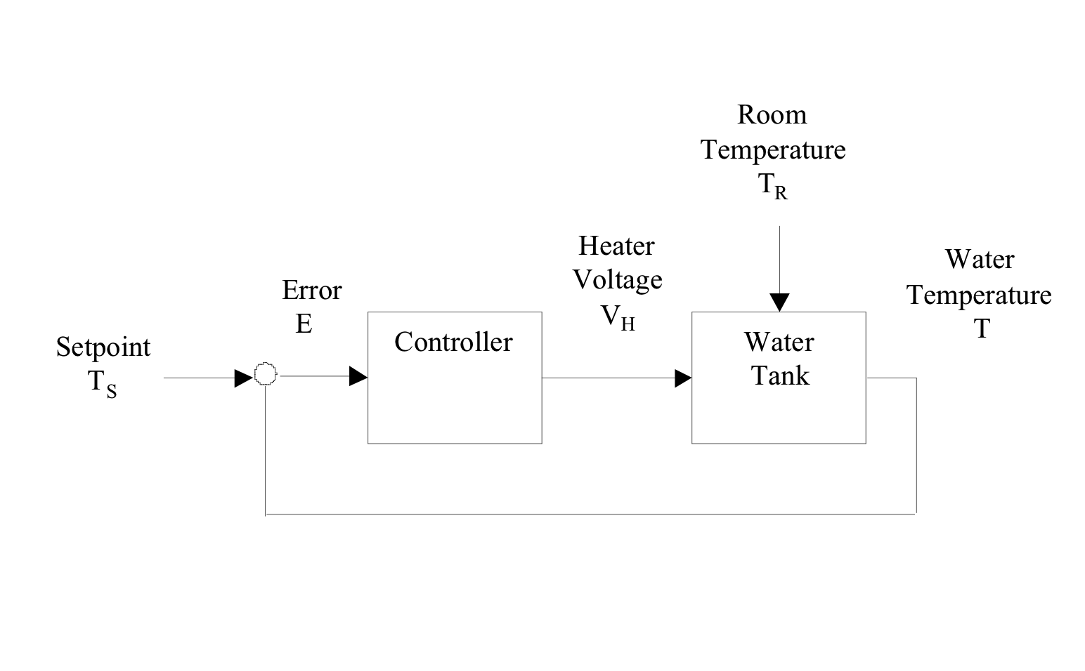
Heater Control Simulation
Typical control loop
PID Controller
  O(n) = K_{P} E(n) + K_{I}Σ_{i}E(i) dT + K_{D} [E(n)-E(n-1)]/dT
  Error readings E(n)
  Output O(n)
  Proportional, Integral, Derivative Gains K_{x}

Slide 28
User Inputs to Simulation
Macros
Analog output for user input because of DRVL/DRVL
record(ao, "$(user):room")
{
field(DESC, "Room Temperature")
field(EGU, "C")
field(HOPR, "40")
field(LOPR, "0")
field(DRVL, "0")
field(DRVH, "40")
field(DOL, "25")
field(PINI, "YES")
}
record(ao, "$(user):setpoint")
{
field(DESC, "Temperature Setpoint")
field(EGU, "C")
field(HOPR, "0")
field(LOPR, "100")
field(DRVL, "0")
field(DRVH, "100")
field(PREC, "1")
field(DOL, "30")
field(PINI, "YES")
}

Slide 29
Simulated Tank Temperature
# supervisory: user can adjust voltage
# closed_loop: PID (in separate control.db) sets voltage
# When PID is INVALID, go back to 0 voltage
record(ao, "$(user):heat_V")
{
field(DESC, "Heater Voltage")
field(EGU, "V")
field(DRVL,"0")
field(DRVH,"110")
field(DOL, "$(user):PID MS")
field(OMSL,"closed_loop")
field(IVOA, "Set output to IVOV")
field(IVOV, "0")
}
# ~1100 Watt heater when run with 110V:
# P = U I = U^2 / R, R~12 Ohm
record(calc, "$(user):heat_Pwr")
{
field(DESC, "Heater Power")
field(EGU, "W")
field(INPA, "$(user):heat_V PP NMS")
field(CALC, "A*A/12.1")
}
# Every second, calculate new temperature
# based on current temperature,
# room temperature and heater
#
# A - current temperature
# B - room temperature
# C - heater power
# D - isolation factor (water <-> room)
# E - heat capacity (would really depend on water volume)
#
# Very roughly with
# T(n+1) = T(n) + [Troom-T(n)]*Isolation_factor
# + heater_pwr * heat_capacity
record(calc, "$(user):tank_clc")
{
field(DESC,"Water Tank Simulation")
field(SCAN,"1 second")
field(INPA,"$(user):tank_clc.VAL")
field(INPB,"$(user):room")
field(INPC,"$(user):heat_Pwr PP NMS")
field(INPD,"0.01")
field(INPE,"0.001")
field(CALC,"A+(B-A)*D+C*E")
field(FLNK,"$(user):tank")
}

Slide 30
PID (without D) by Hand
# Error computation’s SCAN drives the rest
record(calc, "$(user):error")
{
field(DESC, "Temperature Error")
field(SCAN, "1 second")
field(INPA, "$(user):setpoint")
field(INPB, "$(user):tank MS")
field(CALC, "A-B")
field(PREC, "1")
field(FLNK, "$(user):integral")
}
# Integrate error (A) but assert that
# it stays within limits (C)
record(calc, "$(user):integral")
{
field(DESC, "Integrate Error for PID")
field(PREC, "3")
field(INPA, "$(user):error PP MS")
field(INPB, "$(user):integral")
field(INPC, "20.0")
field(CALC, "(B+A>C)?C:(B+A<-C)?(-C):(B+A)")
field(FLNK, "$(user):PID")
}
# PID (PI) computation of new output
# A - Kp
# B - error
# C - Ki
# D - error integral
record(calc, "$(user):PID")
{
field(DESC, "Water Tank PID")
field(PREC, "3")
field(LOPR, "0")
field(HOPR, "110")
field(INPA, "10.0")
field(INPB, "$(user):error MS")
field(INPC, "5.0")
field(INPD, "$(user):integral MS")
field(CALC, "A*B+C*D")
}

Slide 31
Heater Simulation

Slide 32
Alarms
Common fields:
  SEVR: Alarm Severity
    NONE, MINOR, MAJOR, INVALID
  STAT: Alarm Status
    UDF, READ, WRITE, CALC, HIGH, …
Binary records:
  ZSV, OSV: Severity for ‘zero’ and ‘one’ state
Analog records:
  LOLO, LOW, HIGH, HIHI: Thresholds
  LLSV, LSV, HSV, HHSV: Associated severities
  HYST: Hysteresis

Slide 33
Alarm Example
# Raise MAJOR alarm when temperature near boiling point
record(ai, "$(user):tank")
{
field(DESC,"Water Temparature")
field(SCAN,”…
field(INP, ”…
field(EGU, ”C")
field(HIGH,”90")
field(HSV, ”MAJOR")
}

Slide 34
Summary
Database Records configure the IOC’s data flow
  Fields, links instead of custom code
There’s more
  Fields MDEL/ADEL, bo.HIGH
  Access security
See http://aps.anl.gov/epics for
  IOC Application Developers’ Guide
  Record Reference Manual

Slide 35
Things to try
Build a simple on/off fish tank controller
  Simulate the heater
    ‘bo’ record to turn on/off
  Simulate the water temperature
    ‘calc’ record(s):
      Temperature rises when heater is on
      Temperature drops to room temperature when heater is off
  Add controller
    ‘ao’ record to allow entering the desired temperature
    ‘calc’ record(s) to turn heater on/off, automagically keeping water temp. close to setpoint
OK to take inspiration from Heater Control Simulation example
  But don’t copy a single line without understanding it
  Compare behavior of the P-I controller with on/off controller

